Slide 1

Guided Capstone Project: Big Mountain Resort
Maria pinzon

Slide 2
Project Identification
The Big Mountain Resort is currently not accurately capitalizing on the facilities that they offer such as the incredible views of both Glacier National Park and Flathead National Forest and the new installation of an additional chair lift that accommodates more costumers per day around the resort. They hope to develop a model that can help them determine a ticket price that will more appropriately reflect their facilities and their competitive nature in the current market.

Slide 3
Recommendations
My recommendations after applying the model is for the business team to approve an increase of the vertical drop by 150 feet, addition of a run, installation of an additional chair lift and optionally, addition of 2 acres of snow making area. The model showed that this would support the highest amount in ticket increase and therefore the highest increase in revenue.

Slide 4
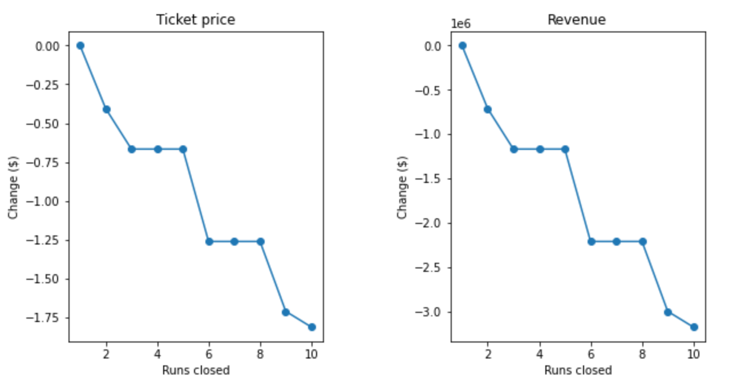
Modeling Results and Analysis
Various scenarios were posed to test the model and these were the results
Scenario 1: Permanently closing a determined amount of runs that are least used.
The model showed that this would ultimately just support a decrease in ticket price. As the amount of runs that are closed down, the ticket price would have to decrease more.

Slide 5
Modeling Results and Analysis
Scenario 2: A run is added, the vertical drop is increased by 150 feet and an additional chair lift is added.
The model shows that this scenario would increase support for ticket price by $8.61. This would increase the revenue amount for the season by $15,065,471.
Scenario 3: Similar to Scenario 2, but an additional 2 acres of snow making area.
This would increase support by $9.90 and in turn this would increase revenue by $17,322,717

Slide 6
Modeling Results and Analysis
Scenario 4: The longest run is increased by 0.2 miles and 4 acres of snow making area are added.
This ultimately showed to make no difference on the ticket price whatsoever.

Slide 7
Conclusion
The model shows that the number of Fast Quads, Runs, Snow Making Area and Vertical Drop are the top features that affect ticket price, in decreasing importance. The model could be applied to more scenarios that involve changes to these features, though 2 scenarios have been determined to support the highest ticket price increase that appropriately capitalizes on the facilities that have been shown to be top quality when compared in market value. This scenarios would support maintenance costs and increase revenue per season, ultimately.

